Slide 1
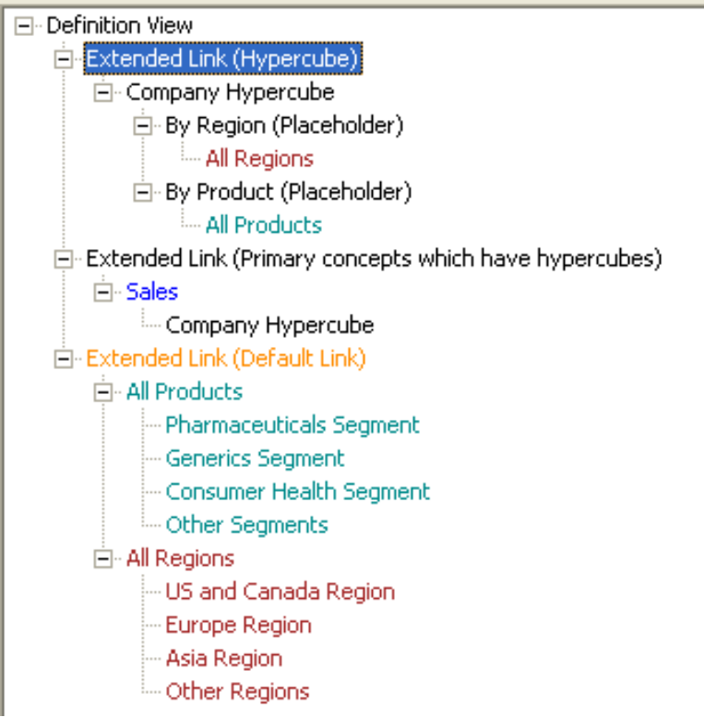
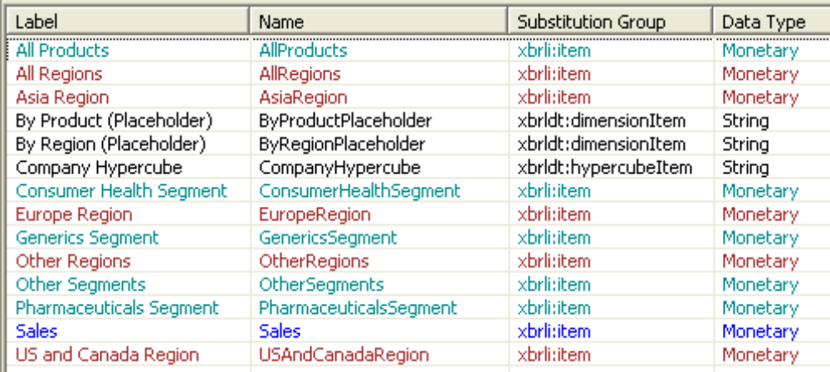
Dimension aggregation
Test aggregation of each member
Products & region dimensions have member hierarchy

Slide 2
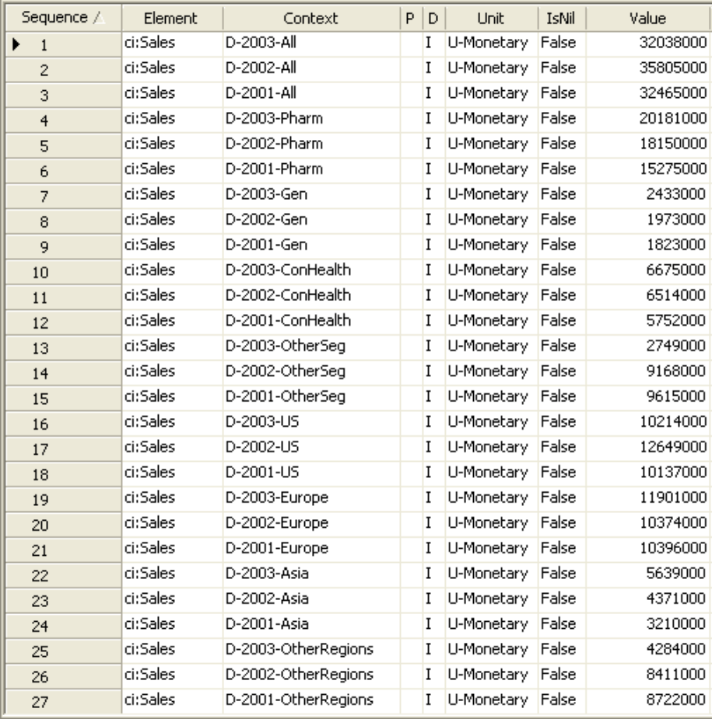
Pharmaceutical example
Multiple periods for used dimensions
Multiple dimensions per contexts
(Charlie’s aggregation example)

Slide 3
Two dimensions to check
Will require checking of aggregation for
  Product dimension
  Region dimension
Formula shown for product dimension
(region is duplicated except for dimension name)
Demonstrates mixed explicit/implicit dimension filtering

Slide 4
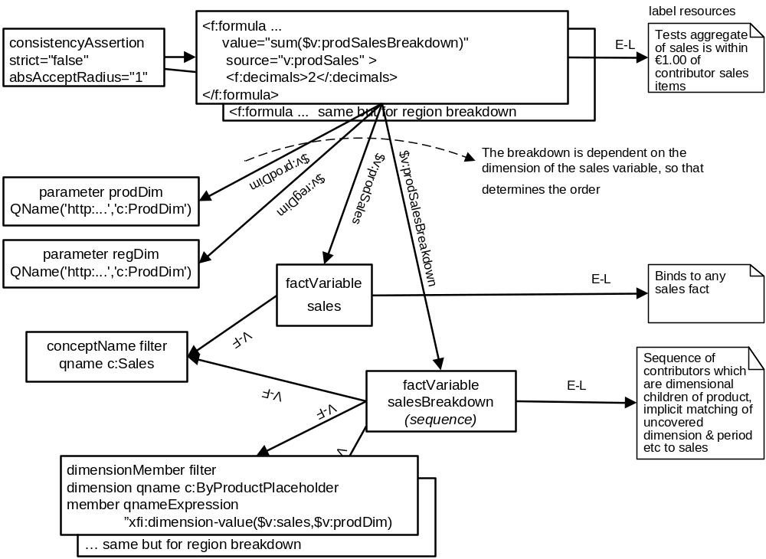
Aggregation consistency

